Slide 1
Digital Marketing Budget Allocation Plan
for Neeman's Footwear

Slide 2
Summary
The scheme describes how a startup focusing on Neeman's shoes, durable and comfortable footwear, a monthly digital marketing budget of ₹40,000 should be spent in various channels. The target access is to maximize access, return on investment and maximize the impact on sales funnel. Budget allocation is designed for Neeman's target audience, which includes youth, environment consumed in India. This highlights channels that promote brand visibility and improve e-commerce conversions.

Slide 3
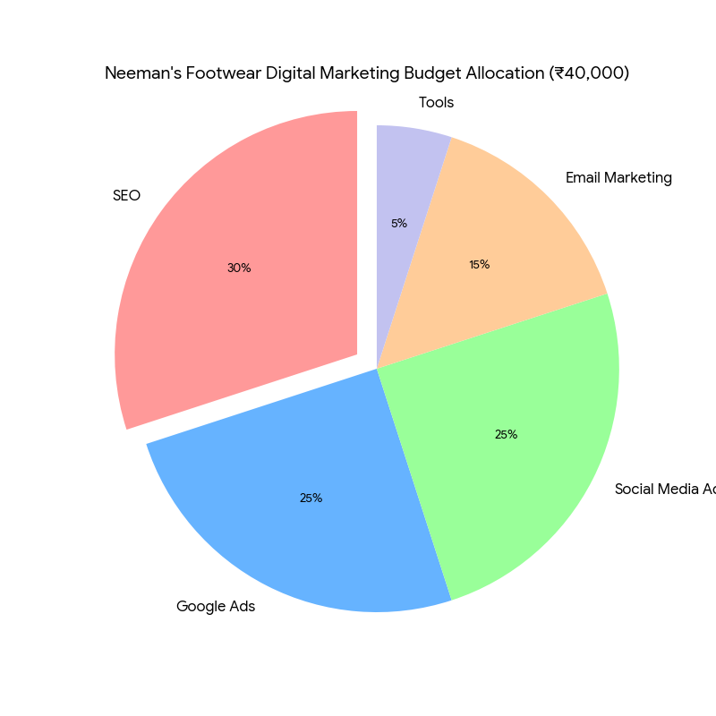
Budget Allocation Breakdown
SEO (Search Engine Optimization): ₹12,000 (30%)
Google Ads: ₹10,000 (25%)
Social Media Ads: ₹10,000 (25%)
Email Marketing: ₹6,000 (15%)
Tools (Canva Pro, Mailchimp, etc.): ₹2,000 (5%)
Total: ₹40,000

Slide 4
SEO (₹12,000, 30%)
• Justification: SEO is important for Neeman to run biological traffic on its e-commerce website, especially for discoveries like "Sustainable Footwear India" or "comfortable shoes online". Investment in material marketing (eg. blog on environmentally friendly material) and on-page adaptation will create long-term visibility.
• Estimated effect: Upper funnel (awareness). Organic search drive 50% E-commerce traffic (per statistical), with high ROI due to low running costs. Targeting the niche keyword can provide 500–1,000 monthly organic trips within 6 months.
• Activities: Keyword research for environmentally friendly shoes, blog posts on stability, and technical SEO (eg. site speed, mobile adaptation).

Slide 5
Google Ads (₹10,000, 25%)
• Justification: Google advertisements target high-intent buyers in search of footwear, which ensures immediate traffic on Neman's product pages. Search and shopping advertising can demonstrate specific products such as sneakers or loafers, driving conversion.
• Estimated effect: Middle-to-low funnel (thought and conversion). The Google advertisement usually provides 2: 1 ROI (according to the Google 2 revenue per, 1 expenditure, according to the Google Economic Impact Report). The budget of ₹10,000 can generate 100-150 clicks at 70–100 CPC, with a 5–10% conversion rate.
• Activities: Find advertisement for high-intent keywords (eg. "Sustainable Sneakers"), Google shopping advertising and remarketing campaign.

Slide 6
Social Media Ads (₹10,000, 25%)
• Justification: Neeman's eco-conscious audiences are active on Instagram and Facebook, where blind appeal advertisements can highlight permanent materials and stylish designs. Social advertisements are ideal for storytelling and brand awareness.
• Estimated effect: upper-to-medium funnel (awareness and thoughts). With an average CPM of ₹50-100 in India, of 10,000-20,000 can get the impression, run the visits of the 200-300 website at 2-3% click.
• Activities: Instagram reels showcasing footwear craftsmanship, Facebook Hindola Advertisement for Product Collection, and LinkedIn Advertisement for B2B partnership (eg. bulk order).

Slide 7
Email Marketing (₹6,000, 15%)
• Justification: Email marketing nutrition leads to lead and retains customers through individual proposals, it is important for the purchase of repeat in the shoe industry. With an average ROI of ₹40 per ₹1 spent expenditure (DMA insights), it is cost effective to run loyalty.
• Estimated effect: Cap (conversion and retention) below. Emails can achieve 20–30% open rates and 2–5% conversion rates, which can sell repetition for Neeman.
• Activities: welcome series for new customers, promotional emails (eg. discount on environmentally friendly shoes), and abandoned cart recovery email.

Slide 8
Tools - Canva Pro, Mailchimp, etc (₹2,000, 5%)
• Justification: Tools such as Canva Pro (₹499/month) enable Neman to create a compelling view for social advertisements and emails, while Mailchimp (for basic schemes ₹1,000 month) supports email campaigns. Free tools such as Google Analytics meet the needs of tracking.
• Estimated effect: Increases the quality of the campaign in channels, indirectly promotes ROI by reducing design costs and improving efficiency.
• Activities: To establish advertising creative, email template, and analytics dashboard.

Slide 9
Thank You
Presented By :
Name: Madithati Purushotham Sai
Roll No: 2311res31
Mail: madithati_2311res31@iitp.ac.in

